Slide 1
Notes:
Introduce Road Safety Week 2017could be costing lives.

Slide 2
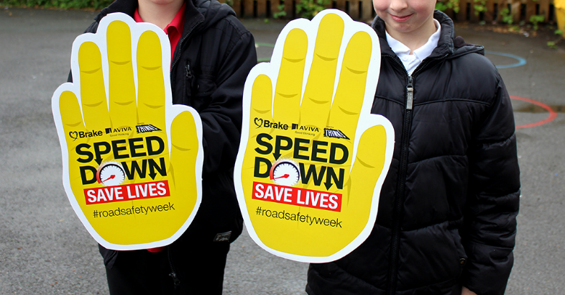
Road Safety Week 2017
will focus on the topic of SPEED.
Speeding is a big problem in the UK and it is a cause of many road crashes.
Notes:
We’re supporting Road Safety Week
Explain to the pupils that you are going to be talking about speed and stopping distances and why drivers should keep to 20mph in places where people live.
Suggested script:
Pupil 1: We’re supporting Road Safety Week.

Slide 3
Driving is unpredictable, and if something unexpected happens on the road ahead – such as a child stepping out from between parked cars – it is a driver’s speed that will determine whether they can stop in time and, if they can’t stop, how hard they will hit.
Notes:
Suggested script:
Pupil 2: In places where traffic mixes people walking and on bikes, the speed limit should be 20mph.

Slide 4
Stopping distances increase with speed
When a car is travelling at 30mph it takes 23 metres to stop. That’s nearly the length of 6 cars.
When a car is travelling at 20mph it only takes 12 metres to stop. That’s the length of 3 cars

Slide 5
20s plenty in places where people live
We want drivers to drive more slowly and slow down to 20mph in places where people live (not just outside our school).
That’s why we are launching a school poster competition to ask all drivers to Speed Down and Save Lives in our community.
Notes:
20s plenty in places where people live

Slide 6
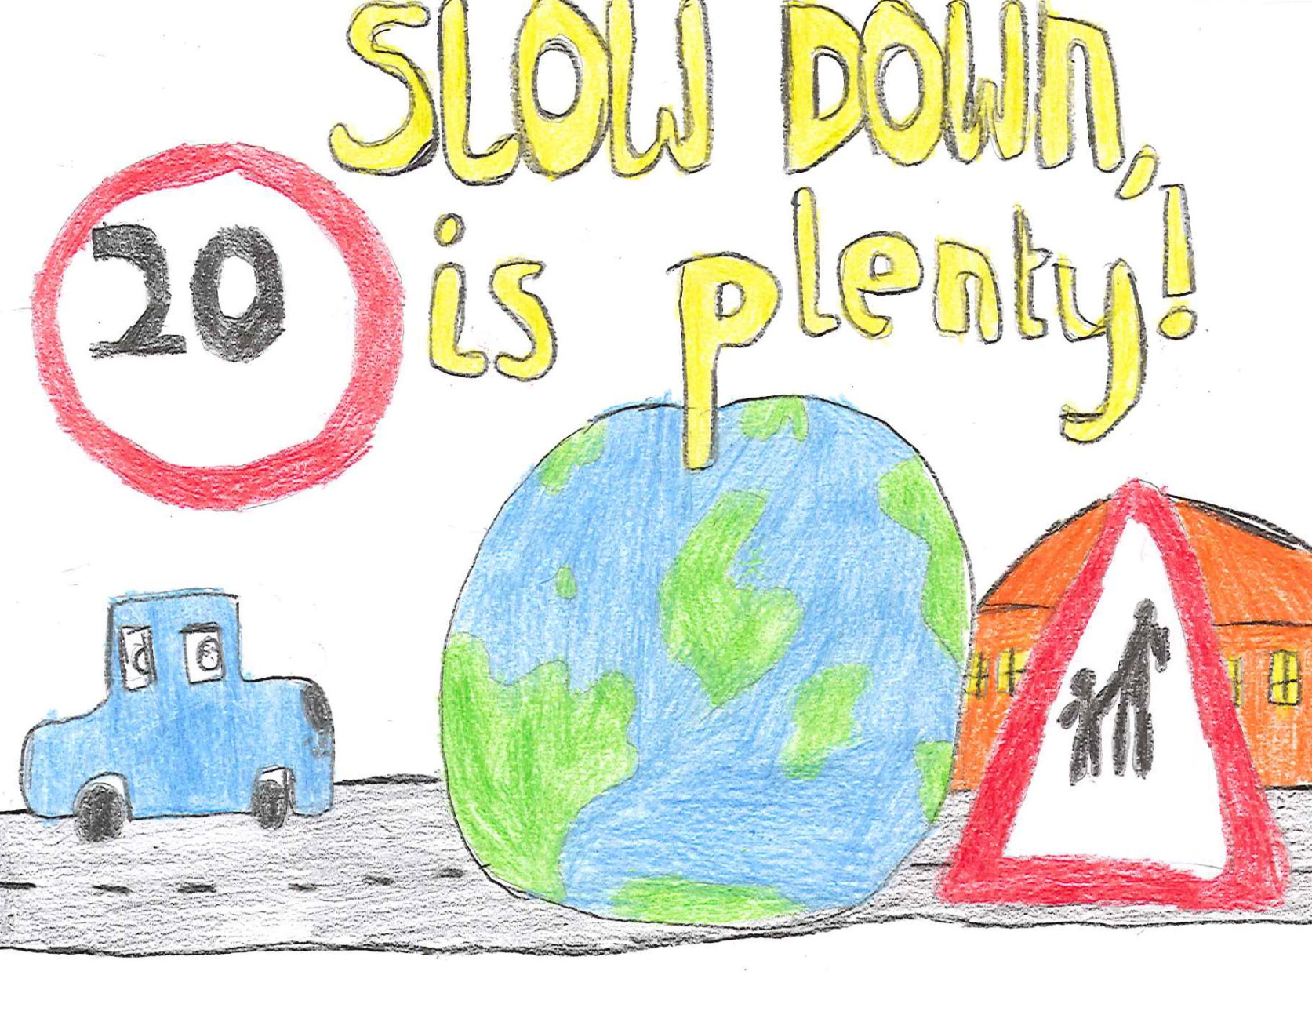
Think about the journeys we make: to school, to visit a friend or relative, or to go to the park.
You need to design a road safety poster calling for all drivers to ‘Speed Down Save Lives’ in our community.
Notes:
School poster competition
Posters should explain to adults why driving too fast in places where people live is bad, using bold, bright, imaginative designs, perhaps including some facts about speeding such as the stopping distance for cars travelling 20mph (12 metres) and 30mph (23 metres) or simple statements about slowing down and staying safe on our roads.

Slide 7
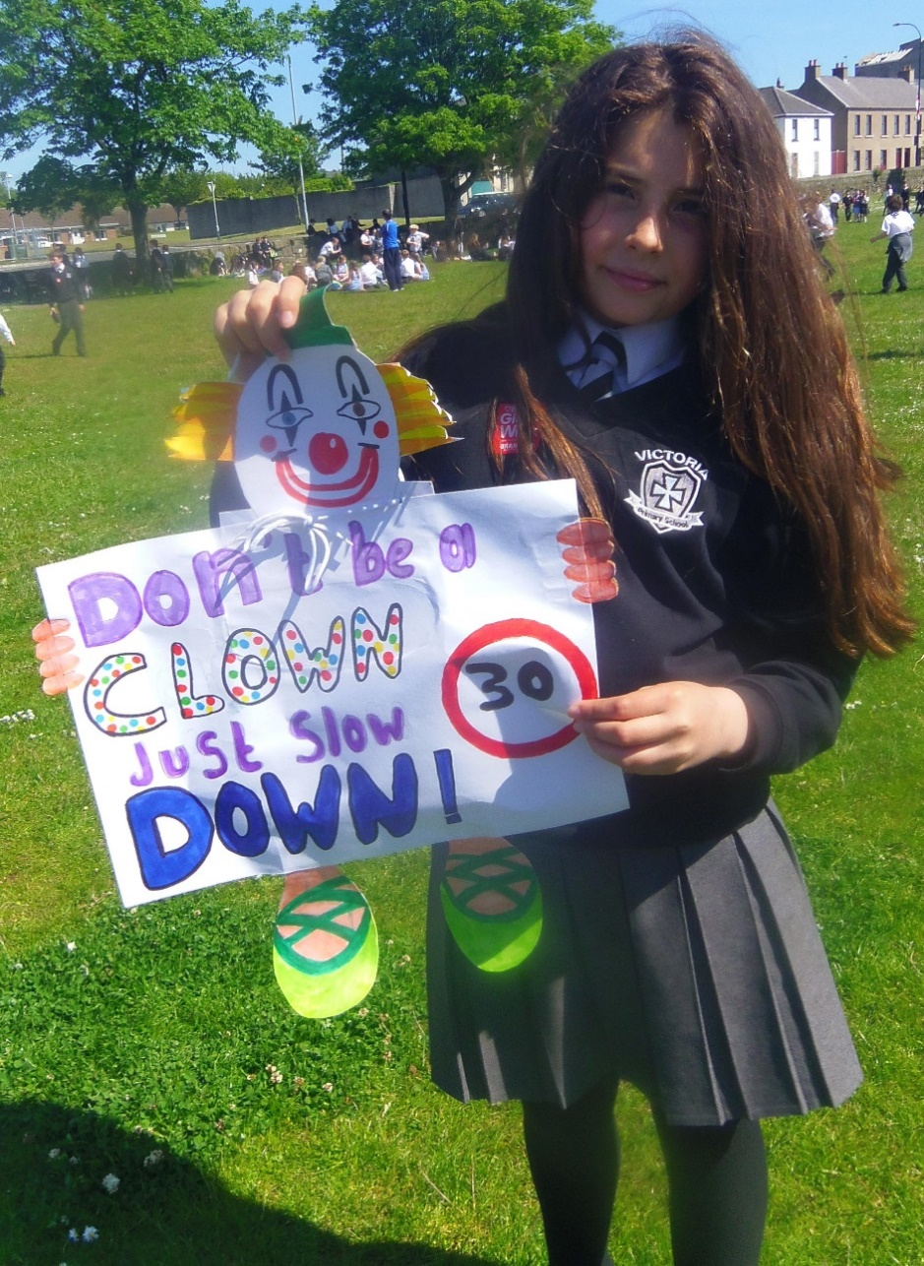
Here’s another example of a road safety poster
Notes:
Poster competition (continued)

Slide 8
Let us watch the video
https://www.youtube.com/watch?v=ZKrejuEtP5w&feature=youtube
Notes:
Quick quiz
Divide the hall into two for a quick quiz. Let’s see what you know about/what you can remember about road safety?
Which two senses should you always use to cross the road safely? (sight and hearing)
Name three places where it is safer to cross the road (three from the following list: subways, footbridges, zebra crossings, puffin crossings, pelican crossings, traffic-light crossings, school crossing patrol/lollipop person)
Name three places you should avoid crossing the road – sharp bends, just before the top of a hill, near parked cars
What do you do if traffic is coming? (let it pass)
True or false? “It’s OK to run across the road if you are in a hurry.” (false – give reasons)
What should the speed limit be in places where people live? (20 mph)
What’s the stopping distance for a vehicle travelling at 20 mph? (12 metres or 3 car lengths)
What’s the stopping distance for a vehicle travelling at 30 mph? (23 metres or nearly 6 car lengths)

Slide 9
Hi -Viz Day
Wednesday
22th November
Now that clocks have gone back and it’s getting darker earlier on it’s important to make sure you can be seen when you’re out and about the roads.
Reflective
Fluorescent
Notes:
Time for reflection
Teacher: Let us all close our eyes. Think about the roads that you cross every day on your journey to school, to visit a friend or relative, or to go to the park.
How can you use your eyes and ears to make your journey safer?
How can we help our grown-ups be safe too?

Slide 10
